Slide 1
6th Grade Social Studies Network
River
Activities
GLCE G1.3.3 Explain different ways in which places are connected and how those connections demonstrate interdependence.
6-G4.4.1 Identify factors that contribute to conflict and cooperation (e.g., control of natural resources, power, wealth).
6-G4.4.2 Evaluate from different perspectives, examples of cooperation and conflict within the region under study.
6-C4.3 Conflict and cooperation between and among nations (3GLCEs)
policies, international issues, treaties, agreements, organizations

Slide 2
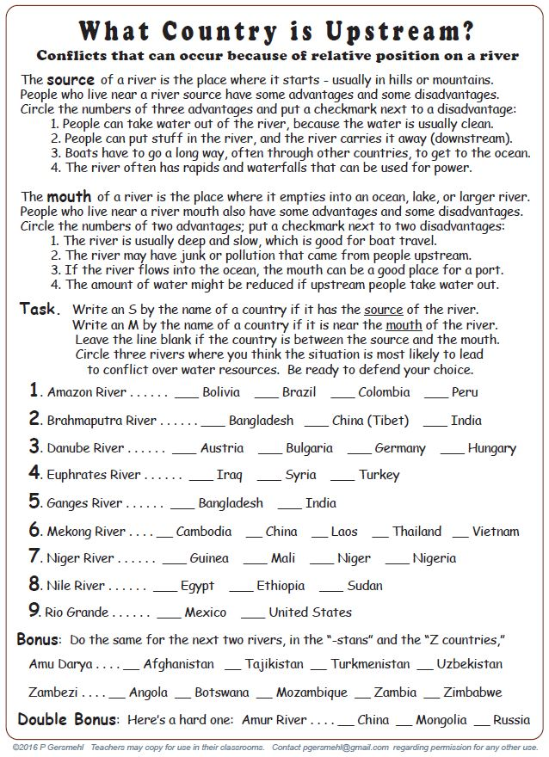
S
M
S
S
M
S

Slide 3
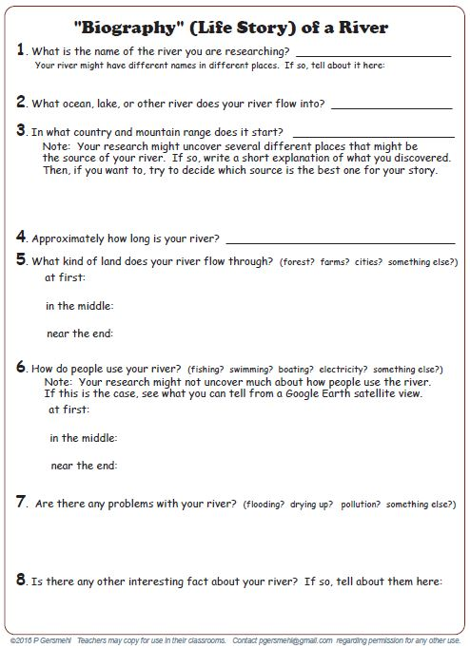

Slide 4
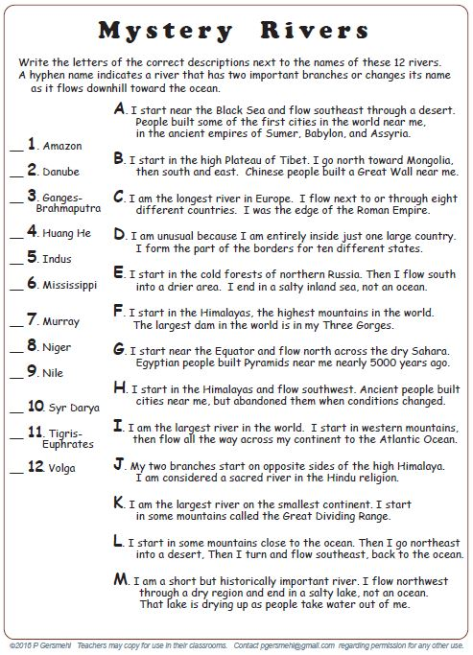
K
A

Slide 5
I
C
J
B
H
D
K
L
G
M
A
E

Slide 6
review
Why are rivers a potential cause for conflict?
Because people use rivers in many ways –
for drinking water, waste disposal,
cheap transportation, swimming
fishing. boating, waterskiing . . .
and rivers always flow downhill –
whatever people do in or to a river upstream
will affect the people who live downstream.

Slide 7
Copyright 2016, Phil Gersmehl
Teachers who saw this presentation at a workshop
or downloaded it from our internet site have permission
to make a copy on their own computers for these purposes:
1. to help them review the workshop,
2. to show to colleagues or administrators,
3. to show the presentation in their own classrooms or at sessions they lead at teacher conferences,
4. to use individual frames (with attribution) in their own class or conference presentations.
For permission for any other use,
including posting frames on a personal blog or uploading to any network or website,
contact pgersmehl@gmail.com

